Slide 1
Social Media Impact on Students
Exploring Social Media Usage, Academic Performance, Sleep, and Mental Health.

Slide 2
Objective & Research Question
Objective
Understand social-media usage among students
Examine its association with academic performance
Analyze its relationship with sleep
Analyze its relationship with mental health
Understand overall impact
Main Research Question
How is social-media usage associated with academic performance, sleep, mental health, and overall impact among students?

Slide 3
Dataset Overview
Dataset
1,705 rows
11 columns
Student information
Social-media usage
Academic performance impact
Sleep
Mental health
Overall impact

Slide 4
Data Quality
Data Quality Check
Missing values: 0
Exact duplicate rows: 0
Numerical and categorical variables identified
Student IDs were checked
No rows removed based only on repeated Student IDs

Slide 5
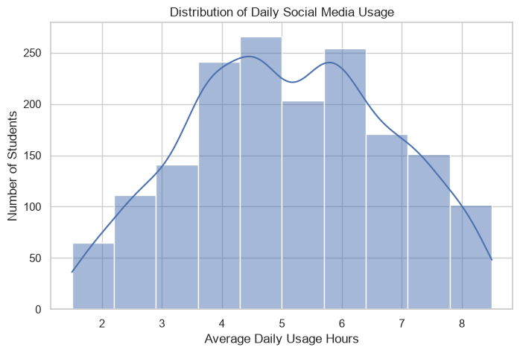
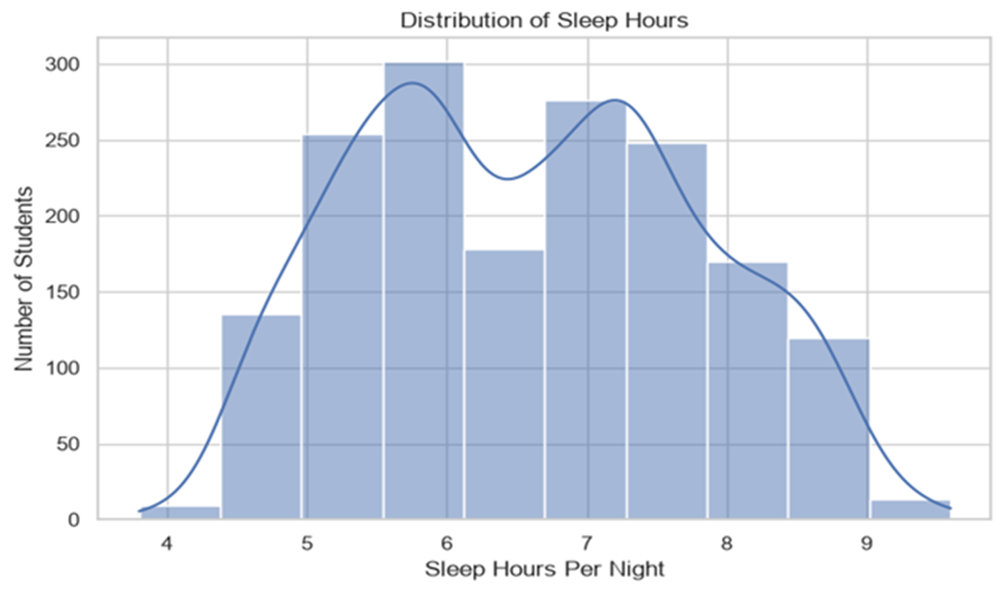
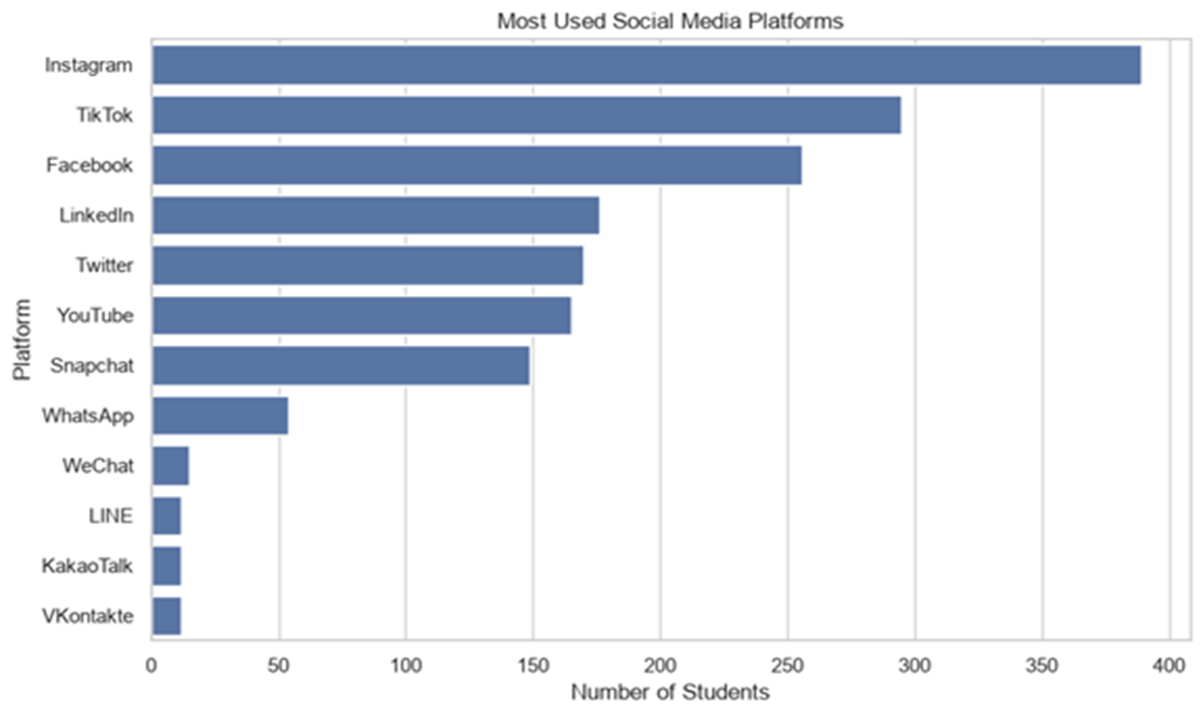
Univariate Analysis

Slide 6
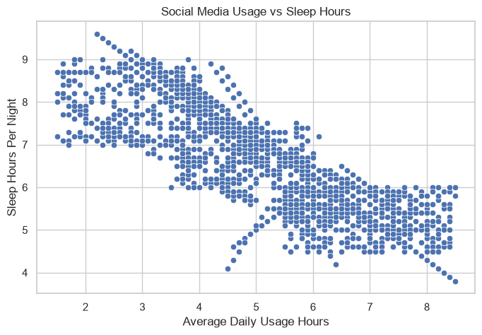
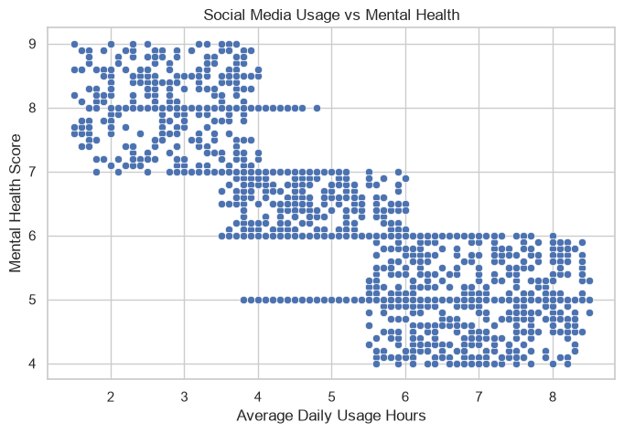
Bivariate Analysis

Slide 7
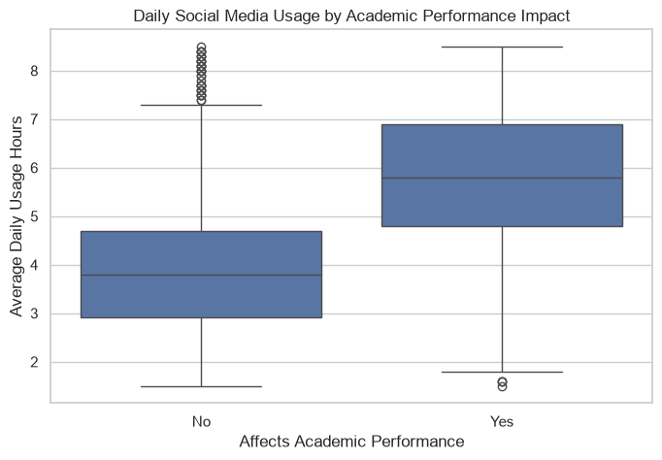
Academic Performance
Academic Impact | Average Usage
No | 4.07 hours
Yes | 5.81 hours

Slide 8
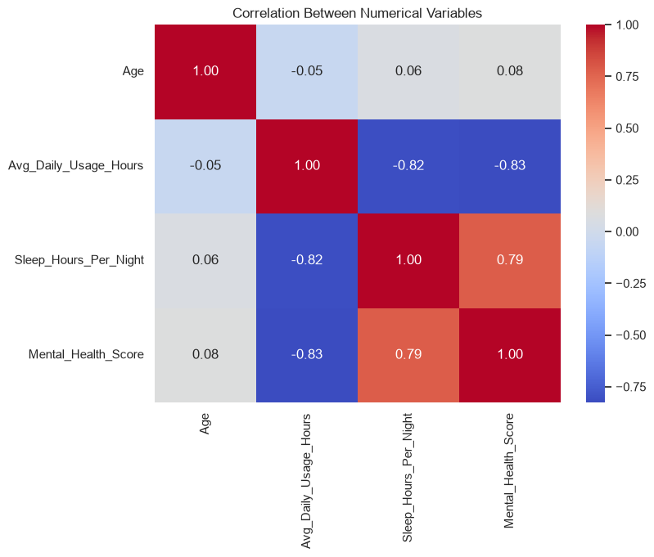
Correlation Analysis

Slide 9
Usage Levels
Low 0–3 hours
Medium 3–6 hours
High 6–9 hours

Slide 10
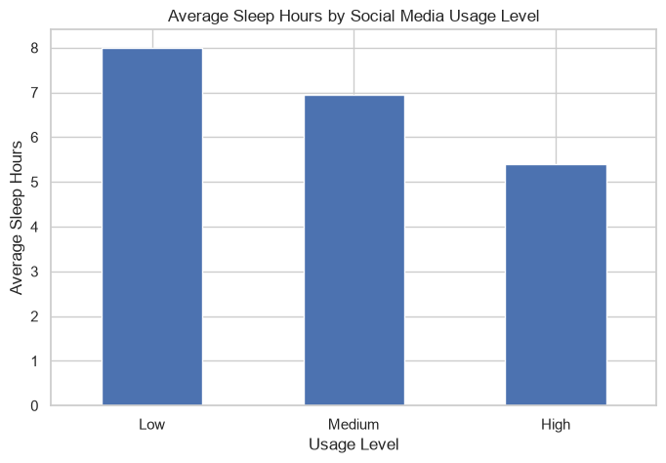
Usage Level vs Sleep

Slide 11
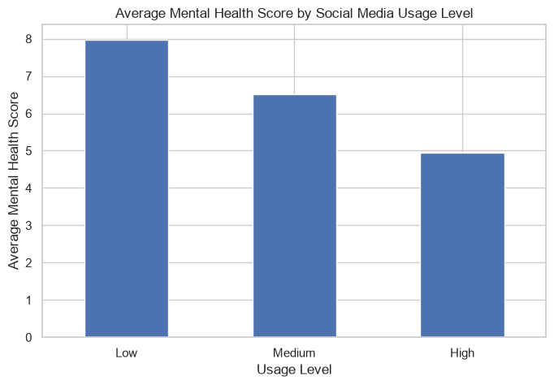
Usage Level vs Mental Health
Low usage → Higher mental-health score
Medium usage → Middle
High usage → Lower mental-health score

Slide 12
Overall Impact
Overall Impact | Usage | Mental Health
Positive | 3.26 hrs | 7.75
Neutral | 4.63 hrs | 6.60
Negative | 6.22 hrs | 5.29

Slide 13
Key Insights
1. Usage
Average daily social-media usage ≈ 5.1 hours
2. Sleep
Higher usage is associated with fewer sleep hours
3. Mental Health
Usage and mental health show a strong negative correlation (-0.83)
4. Academic Performance
The academic-impact “Yes” group has higher average usage (5.81 vs 4.07 hours)
5. Overall Impact
The negative-impact group has higher usage and lower mental-health scores

Slide 14
Limitations
Dataset is social media, not AI
No GPA/actual grades
No addiction score
No AI usage variables
No date/time variable
Correlation does not prove causation
Findings describe this dataset

Slide 15
Conclusion
Higher social-media usage is associated with:
↓ Sleep
↓ Mental-health score
↑ Reported academic-performance impact

Slide 16
THANK YOU!

